Slide 1
General Chemistry (CHM 101) Modern Electronic Theory of Atoms (Continuation)
By
Dr. Edith Ofor

Slide 2
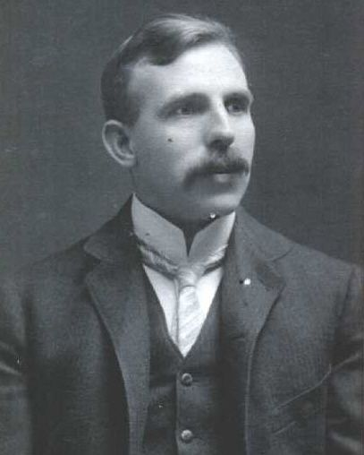
Ernest Rutherford (1911)
Ernest Rutherford, a former
student of J.J. Thomson, father of nuclear physics, proved Thomson's plum pudding structure incorrect.
Knowing that atom contains electrons and possibly positive ion, he carried out the GOLD FOIL EXPERIMENT to know how and where they are located in the atom.

Slide 3
Gold Foil Experiment
Particles shot through thin sheet of gold.
Most shots went straight through.
A small amount were deflected.
Hence… The atoms must be made of mostly empty space with a small dense nucleus.

Slide 4
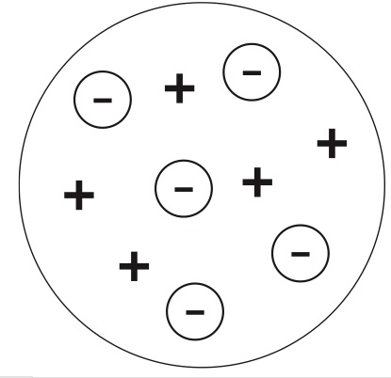
Further explanation of Nuclear Model
If the previous models were correct, alpha particles wouldn’t have passed straight through the gold foil.

Slide 5
Nuclear Model
Rutherford found that most (99%) of the alpha particles that he shot at the gold foil went straight through.
From these experiments Rutherford concluded that the atom had a dense positive core, with the rest composed of mostly empty space with negatively charged electrons.
-
-
-
+
-
-
note: this model completely changed the definition of atom
Notes:
but some bounced off at oblique angles

Slide 6
Rutherford’s Findings
Most of the particles passed right through
Few particles were deflected
* VERY FEW were greatly deflected
Conclusions:
The nucleus is small.
The nucleus is dense.
The nucleus is positively charged.

Slide 7
Question
What causes some of the alpha particles to be deflected, rather than going straight through the foil?

Slide 8
Rutherford’s Conclusion
The atom contains a tiny dense centre called the nucleus whose volume is about 1/10 trillionth the volume of the atom.
The nucleus is essentially the entire mass of the atom.
The nucleus is positively charged: the amount of positive charge of the nucleus balances the negative charge of the electrons.
The electrons move around in the empty space of the atom surrounding the nucleus.

Slide 9
Watch and analyze the video:
https://www.youtube.com/watch?v=dNp-vP17asI

Slide 10
Assignment
1. Who discovered the proton and neutron? Give a summary of the experiments that lead to their discovery.

Slide 11
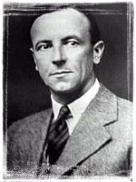
1932 James Chadwick
2. JUST FIND OUT
MORE
James discovered the existence of the neutron.
He found this out because when he was looking at alpha waves(positive charge), bounced off the nucleus, saying there was no charge in the neutron.

Slide 12
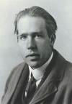

Niels Bohr (1913)
He proposed that electrons are arranged in concentric circular orbits around the nucleus.
electrons exist in several distinct layers or levels.
They can travel around nucleus like planets travel around sun.
Electrons can jump between levels with energy being added/released

Slide 13
Bohr's Model of the Atom
Rutherford's model couldn't explain why unique colours were obtained by atoms of different elements.
Niel Bohr studied the light produced when atoms were excited by heat or electricity
Bohr proposed that electrons are in orbits & when excited jump to a higher orbit. When they fall back to the original state, they give off light.

Slide 14
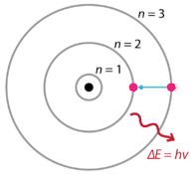
Bohr or Planetary Model
Planetary model because the electrons move round in orbits round the nucleus just like the planets move round the sun.

Slide 15
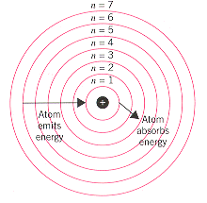
Principal Quantum Energy Levels of the Atom
An atom has only certain allowable (quantized) energy states.
The electron moves around the nucleus in these allowed circular orbits.
The smaller the electron’s orbit, the lower its energy.
Each energy level can hold 2n² of electrons where n = number of energy level. Example: if n = 1, 2n² = 2 (1)² = 2e-

Slide 16
Question
How many electrons can each energy level of the atom hold?
Energy Levels | No. of electrons
1st Energy Level
2nd Energy Level
3rd Energy Level
4th Energy Level
5th Energy Level
6th Energy Level
7th Energy Level

Slide 17
Bohr Model
When the electrons of an atom are in the lowest possible energy level, the atom is said to be in the ground state.
If an atom is exposed to specific amount of energy, its electrons will absorb such energy and travel up to a higher energy level. The atom is then said to be in an excited state.

Slide 18
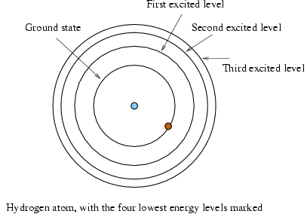
The Hydrogen Atom
The atom absorbs a quantum of energy
The electron travels to a higher energy level
It falls back to the original energy level and gives off an equal amount of energy as light - Photon
Equantum = Ephoton

Slide 19
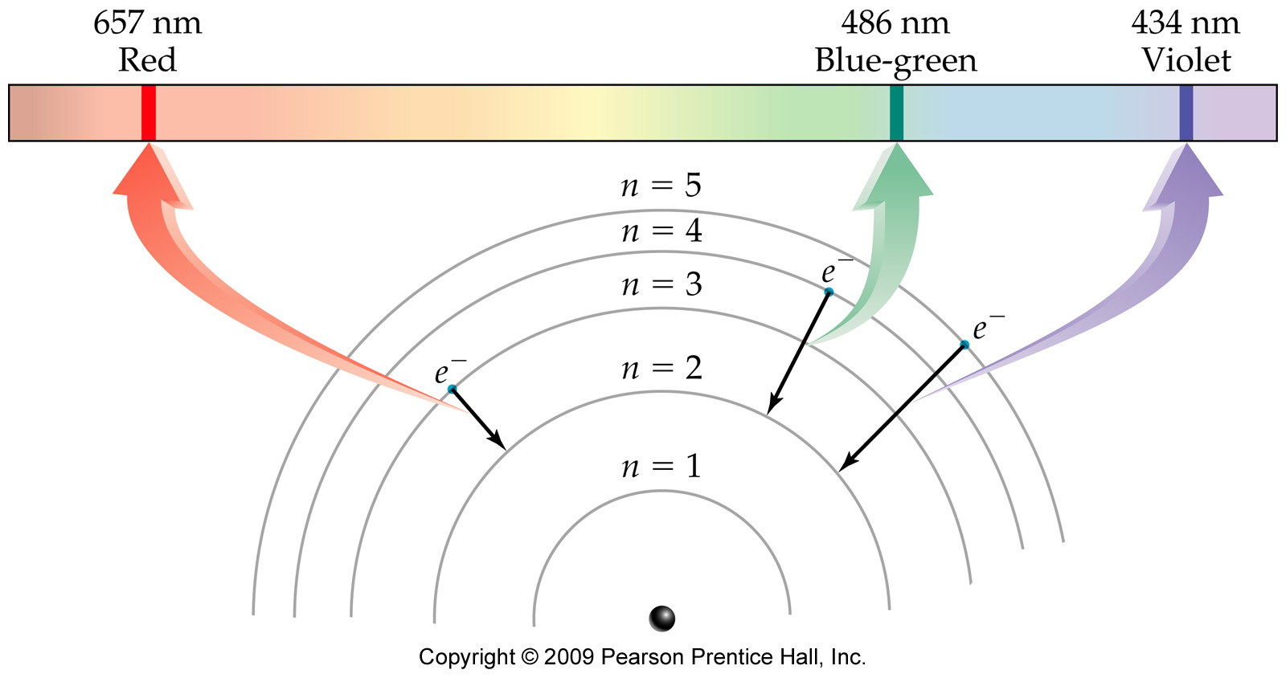
The Bohr Model of the Atom: Hydrogen Spectrum

Slide 20
Emission Line Spectra
The photon of light emitted by an excited atom has a specific wavelength and frequency.
It therefore has a specific color.
These colors are called emission line spectra and are unique to each element.
Identifying elements by their emission spectra is called spectroscopy and the instruments are known as spectrophotometers.

Slide 21
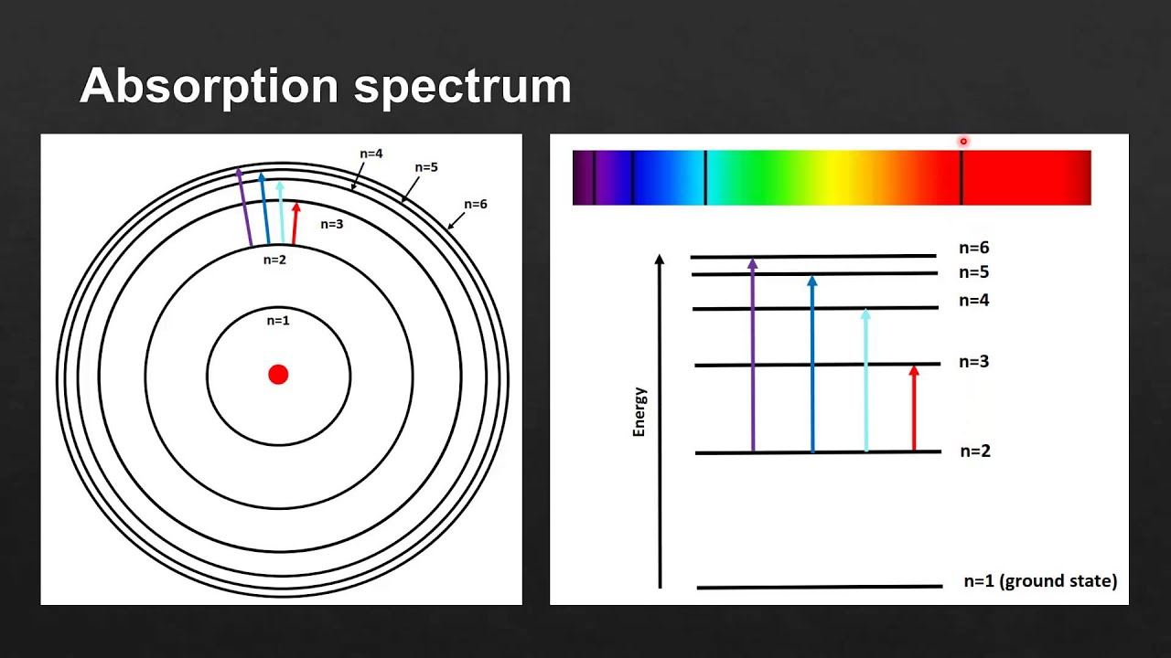
Emission Line Spectra
Each element gives off specific colors of light according to the energy absorbed and emitted.

Slide 22
Bohr’s Conclusion
There is an order of filling the electron orbits:
2 in the first orbit, maximum of 8 in the second orbit, and maximum of 8 in the third… (2,8,8)
Electrons are more stable when closer to the nucleus.
The further away the electrons are from the nucleus, the greater the energy they have.
Electrons can move from one orbit to another, but they don’t exist in between.
Heat, light or electricity can make electrons to jump from one orbit to another.

Slide 23
Question 1
Which would have more energy?
An electron on energy level #4
An electron on energy level # 3

Slide 24
Question 2
For an electron to travel to a higher energy level it must _________.
emit energy of a specific amount
absorb energy of a specific amount

Slide 25
Question 3
The energy, and therefore the frequency and wavelength of light, that en electron gives off when returning from the excited state depends on _______________________.
Which energy level the electron is falling from and to which energy level it is falling to.
The size and mass of the electron.
The color of the electron.
The type of electron.

Slide 26
Erwin Schrödinger (1926)
Erwin Schrödinger, an Austrian physicist, took the Bohr atom model one step further.
used mathematical equations to describe the likelihood of finding an electron in a certain position.
This atomic model is known as the quantum mechanical model of the atom.
Unlike the Bohr model, this model does not define the exact path of an electron, but rather, predicts the odds of the location of the electron.

Slide 27

Quantum mechanical model of the atom.
The quantum mechanical model can be portrayed as a nucleus surrounded by an electron cloud.
Where the cloud is most dense, the probability of finding the electron is greatest, and conversely, the electron is less likely to be in a less dense area of the cloud.
Thus, this model introduced the concept of sub-energy levels.
Quantum mechanical model

Slide 28
Erwin Schrödinger (1926)
Improved on Bohr’s findings.
Found that electrons live in fuzzy regions or “clouds” not distinct orbits.
Electron’s location cannot be predicted.
This model sees the electrons not as individual particles, but as behaving like a cloud.
the electron can be “anywhere” in a certain energy level

Slide 29
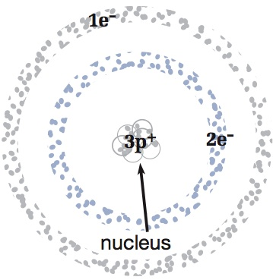
Quantum Mechanical Model
electrons can be found anywhere in these “shells”
note: the electrons are still quantized
no electrons can be found here

Slide 30
James Chadwick (1932)
James Chadwick bombarded beryllium atoms with alpha particles.
An unknown radiation was produced.
He interpreted this radiation as being composed of particles with a neutral electrical charge and the approximate mass of a proton.
This particle became known as the neutron.
With the discovery of the neutron, an adequate model of the atom became available to chemists!

Slide 31
CONCLUSION
Through continued experimentation, many additional particles have been discovered in the atom.
The atomic theory has been further enhanced by the concept that protons and neutrons are made of even smaller units called quarks.
The theory of the composition of the atom continues to be an ongoing and exciting adventure!

Slide 32
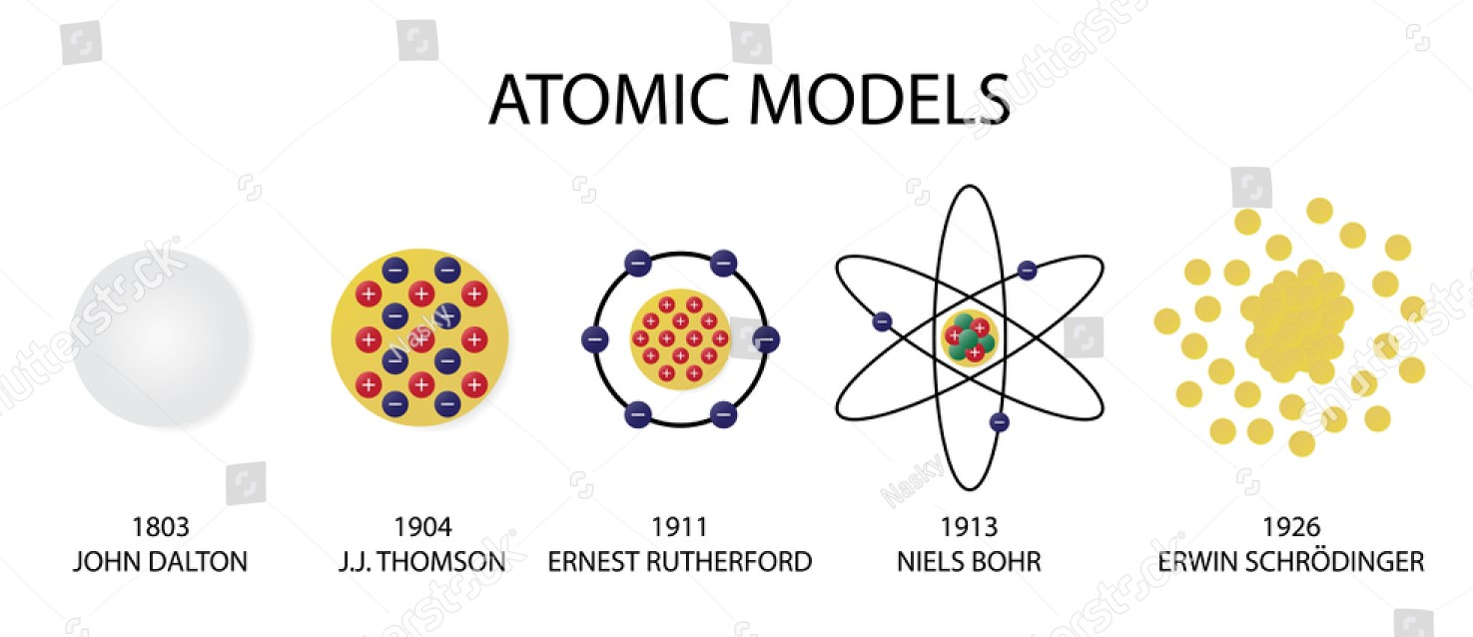
RECAP

Slide 33


